Slide 1
Convert (253)₈ to ( ) ₁₆
Convert (135)₈ to ( )₁₀
Convert (101101100110)₂ to ( )₁₆
Convert (397)₁₆ to ( )₈

Slide 2


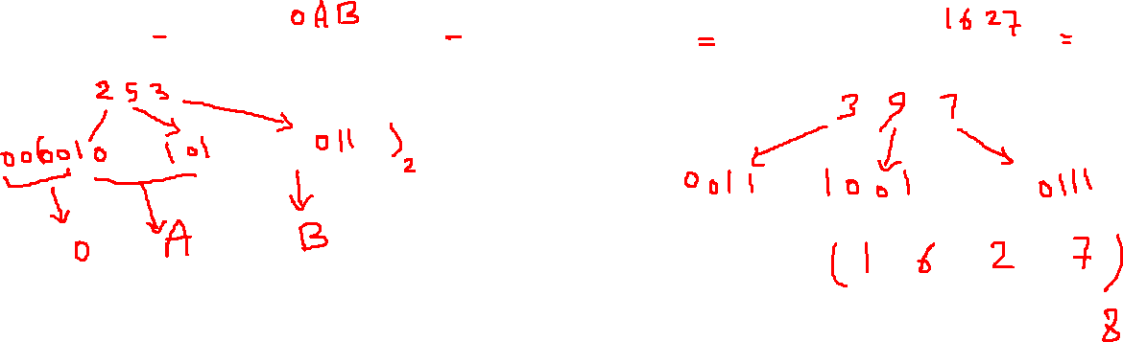


Convert (253)₈ to ( ) ₁₆
Convert (397)₁₆ to ( )₈

Slide 3
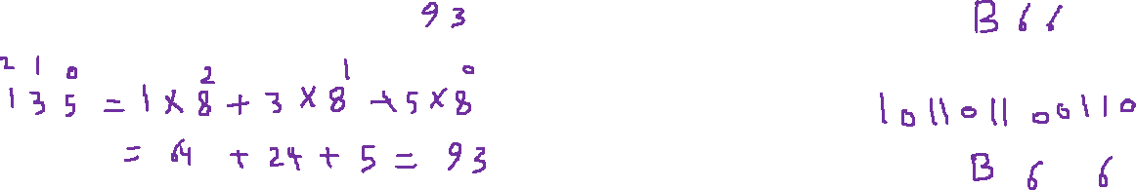
Convert (135)₈ to ( )₁₀
Convert (101101100110)₂ to ( )₁₆

Slide 4
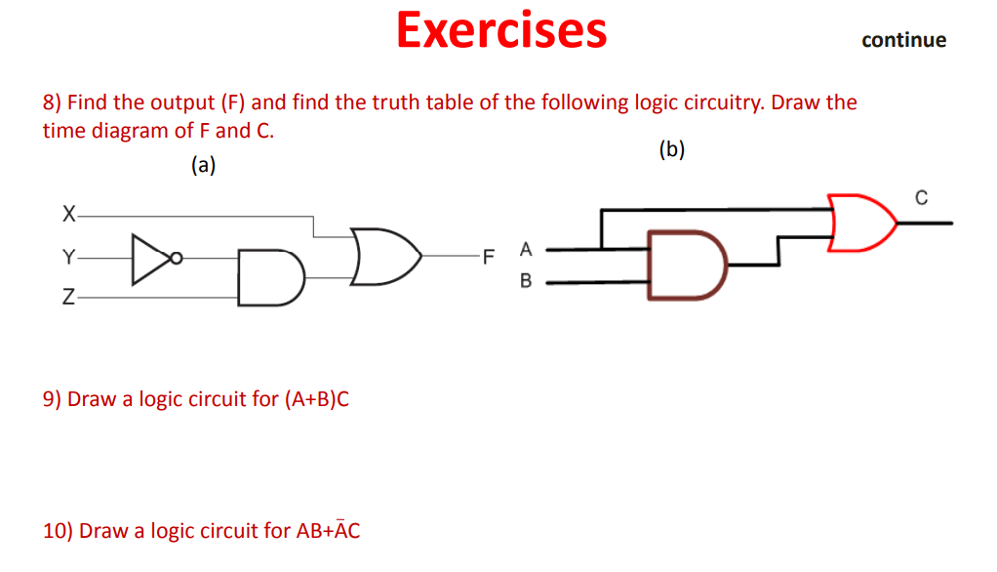

Slide 5

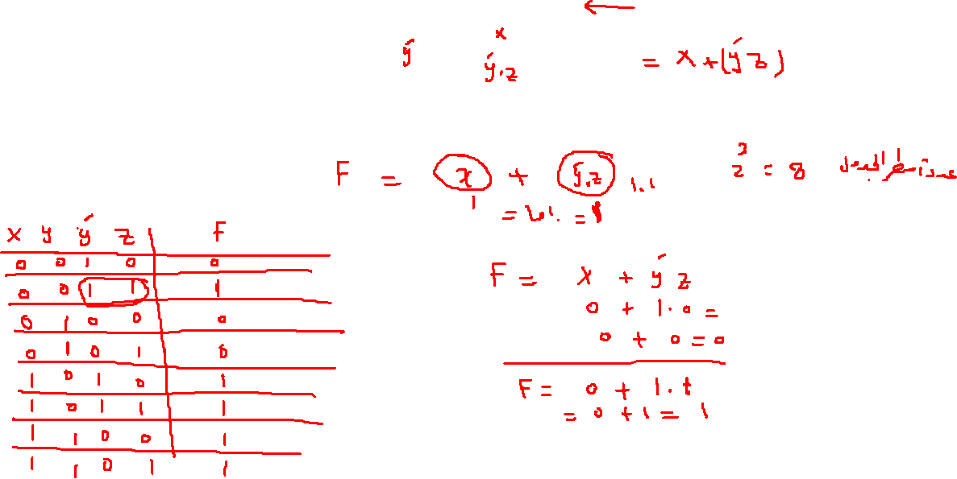

Slide 6
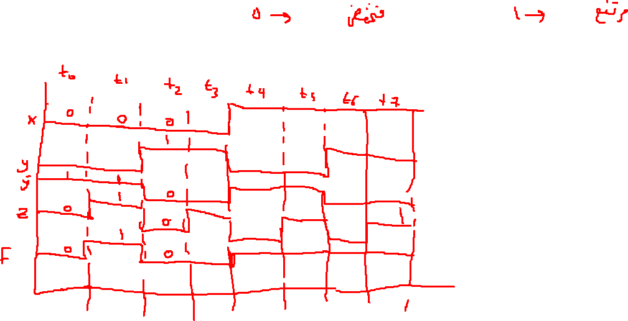

Slide 7
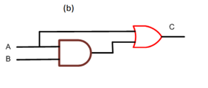
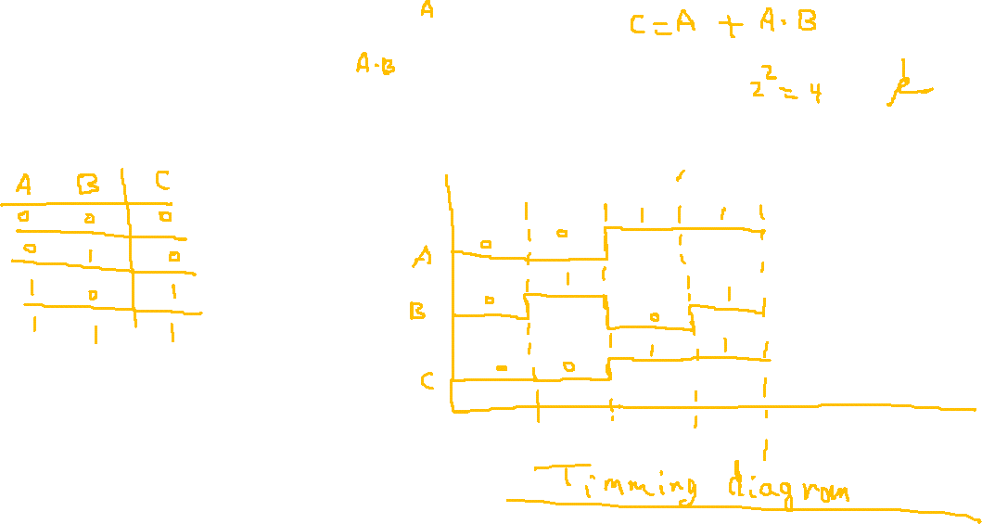

Slide 9
