Slide 1
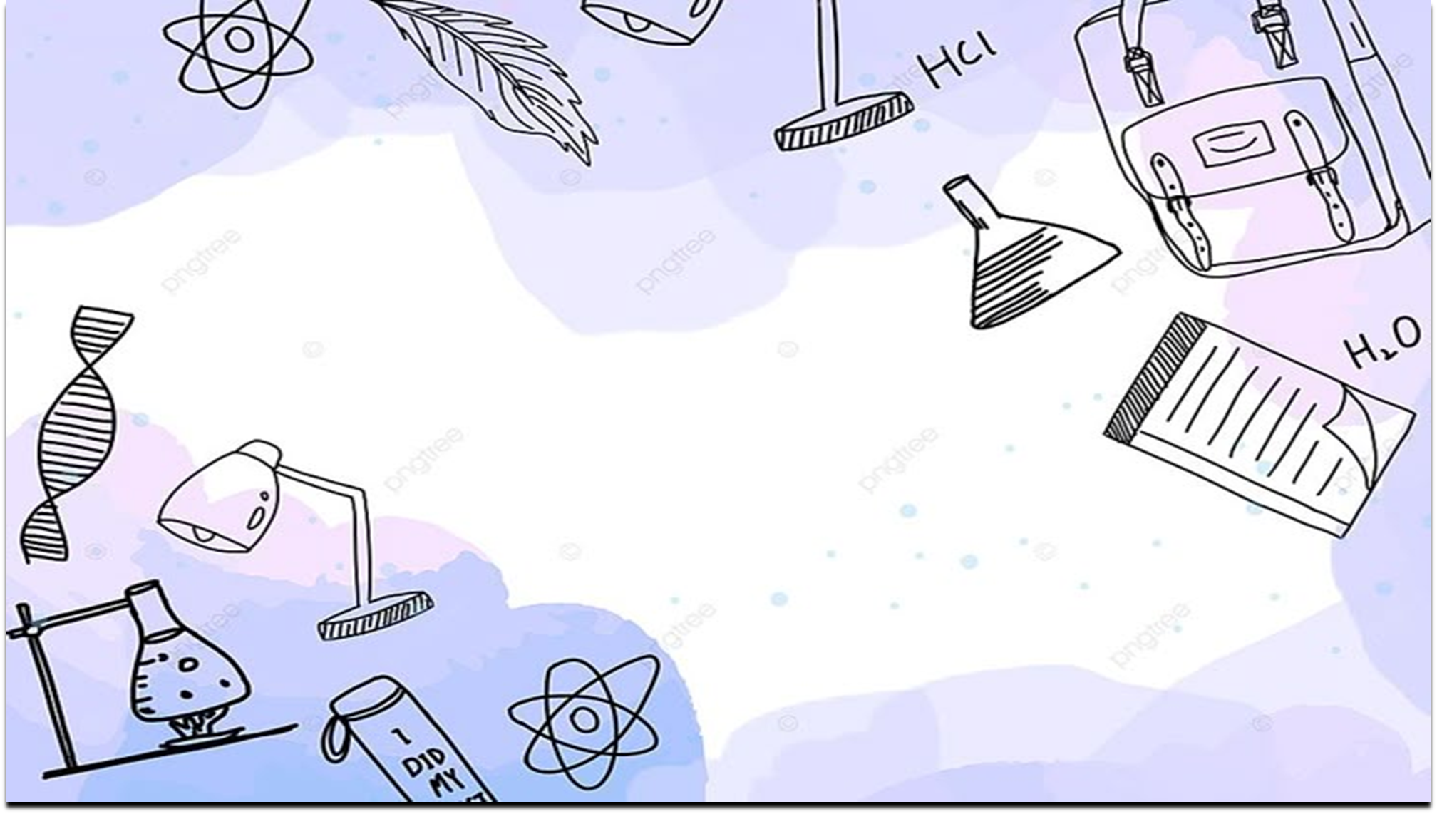

Chapter 1
Problems ( 1-5 )
Ahmad Mohammad Alhumedy --- 0532123904

Slide 2
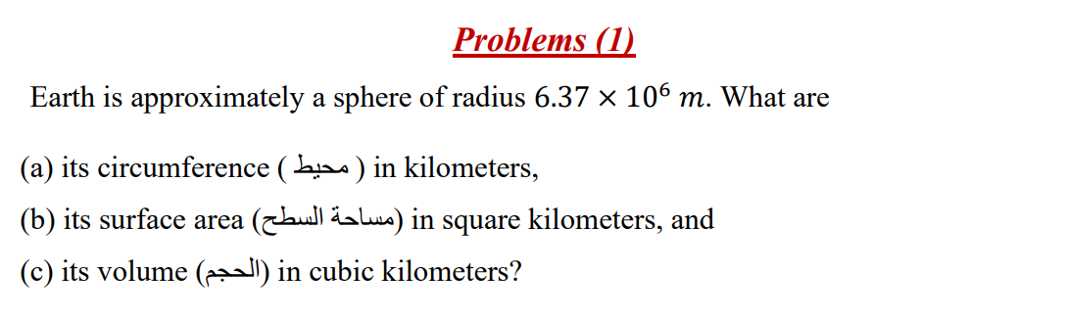

Slide 3
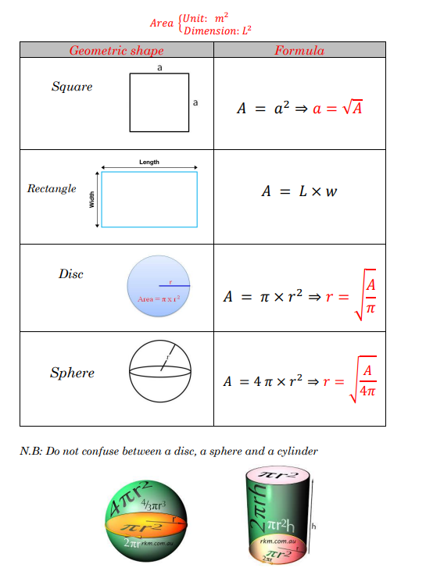

Slide 4
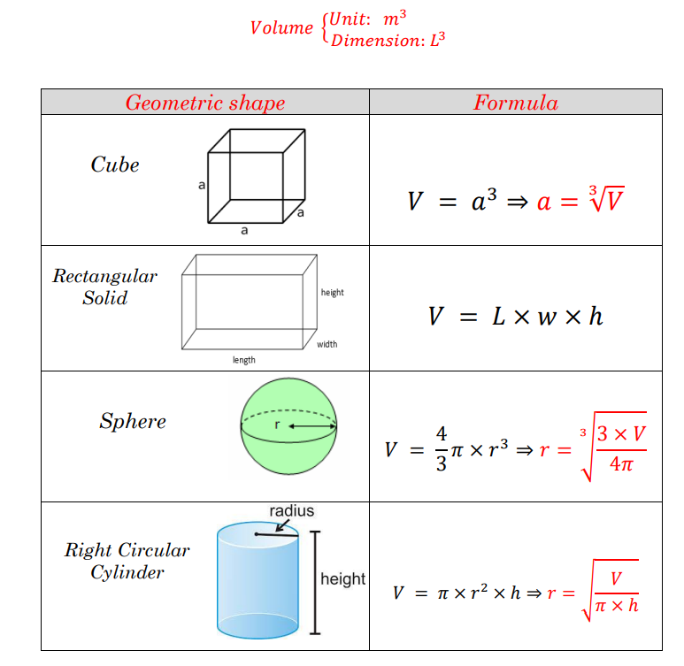

Slide 5
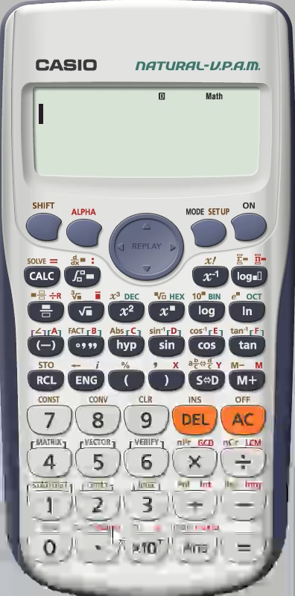

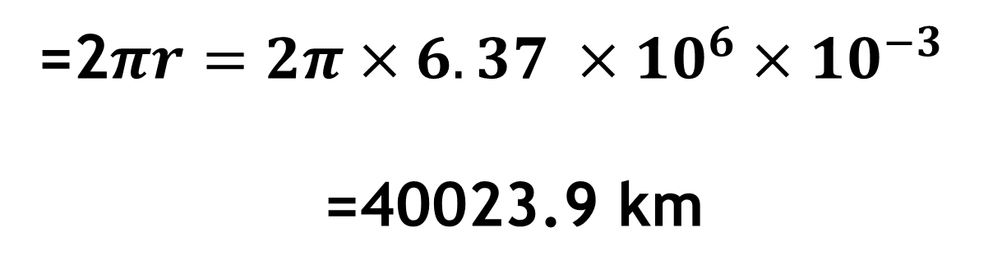
=2$πr=2π×6.37 ×{10}^{6}×{10}^{−3}$
=40023.9 km

Slide 6

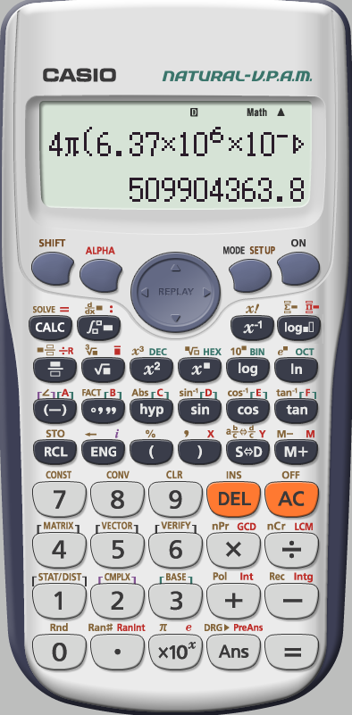
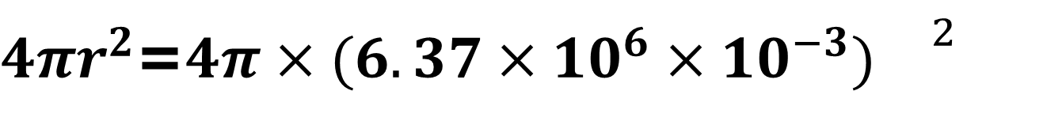

$4πr^{2}$=$4π×(6.37×{10}^{6}×{10}^{−3}){}^{2}$
=$5.09×{10}^{8}$

Slide 7
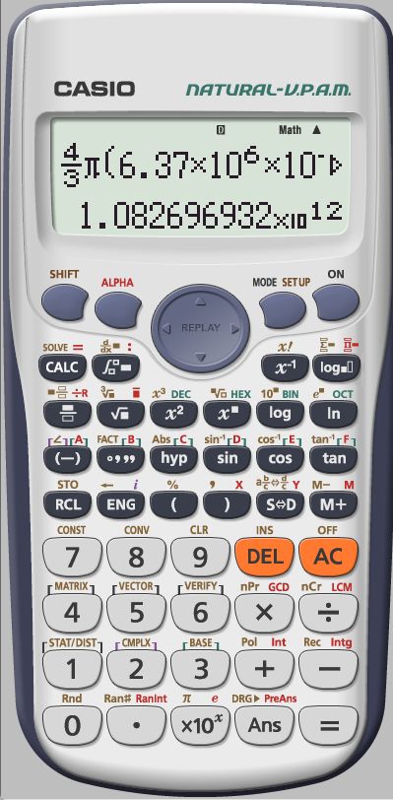


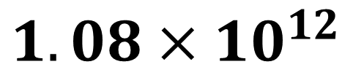
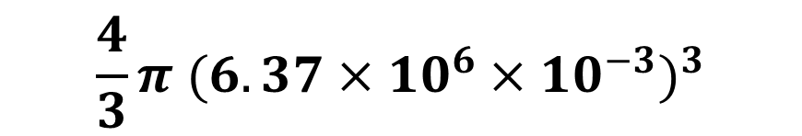
$$\frac{4}{3}π {(6.37×{10}^{6}×{10}^{−3})}^{3}$$
$$1.08×{10}^{12}$$

Slide 8
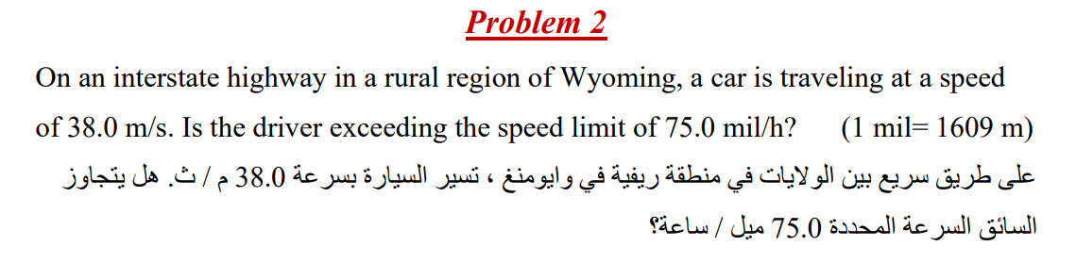
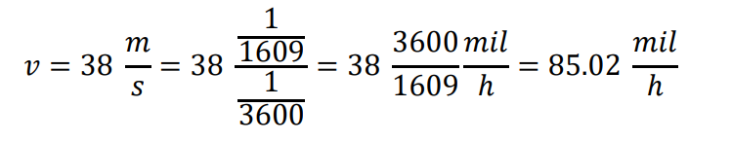

Slide 9
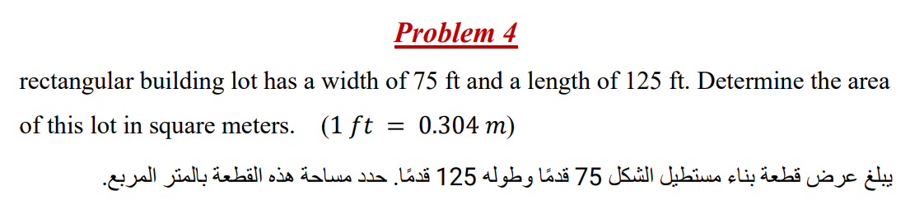
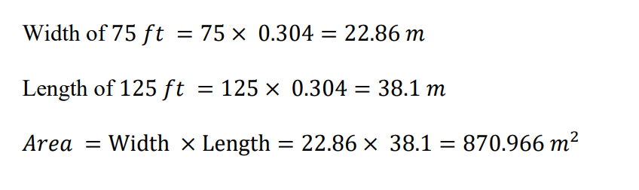

Slide 10
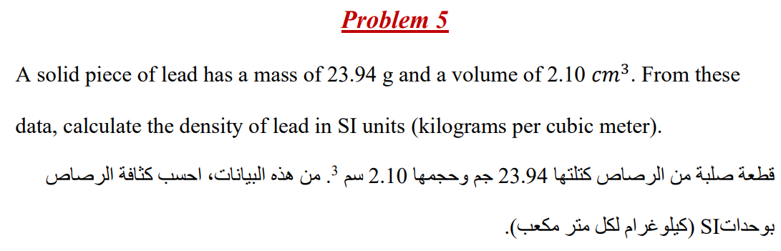
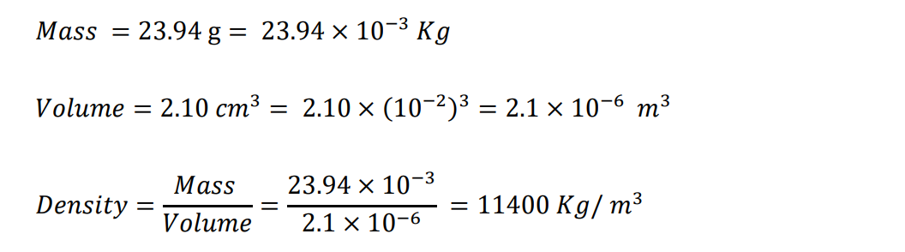

Slide 11


THE END
Ahmad Mohammad Alhumedy --- 0532123904

